Slide 1
Private Labels

Slide 2
Trader Info
Changes have been made to the Trader Information screen to allow FCMs to see exactly which services traders are being billed for. Additionally, by combining features from trader enablements and private label, we have eliminated the need to question which connection type is required for a private label as it is preconfigured.

Slide 3
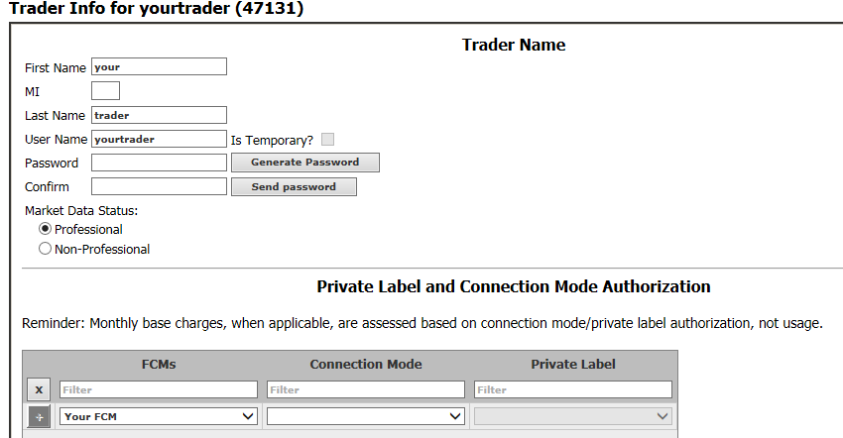
From the Trader Info screen, the Connection Mode and Private Label are set.
By default, your FCM name will appear here. If your CAST user has access to more than one FCM, use the drop-down to select the appropriate FCM name.

Slide 4
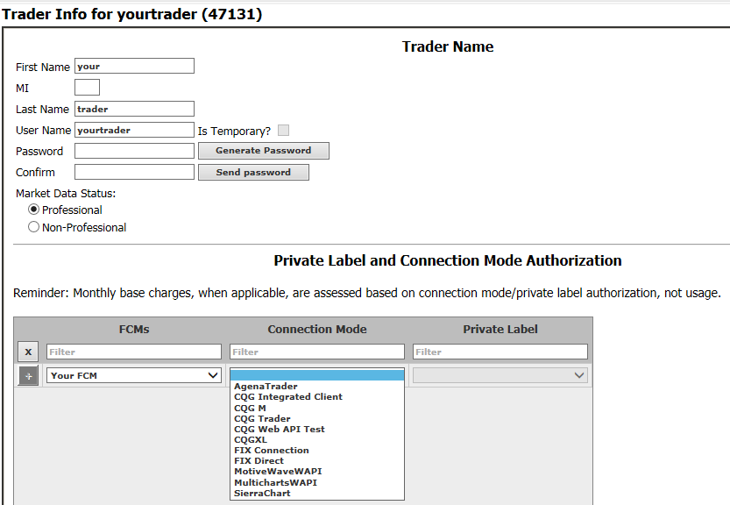
Select the Connection Mode the trader will use.

Slide 5
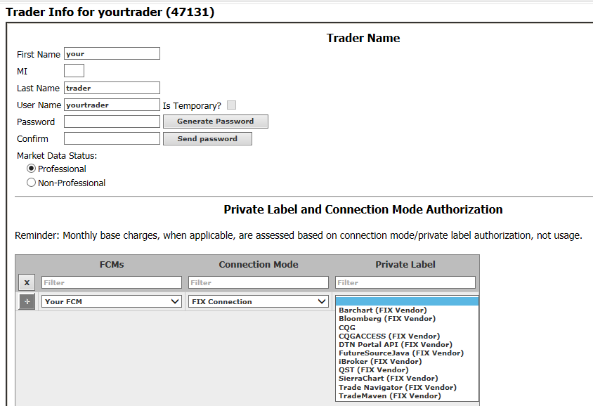
Select the Private Label of the software
your trader intends to use.

Slide 6
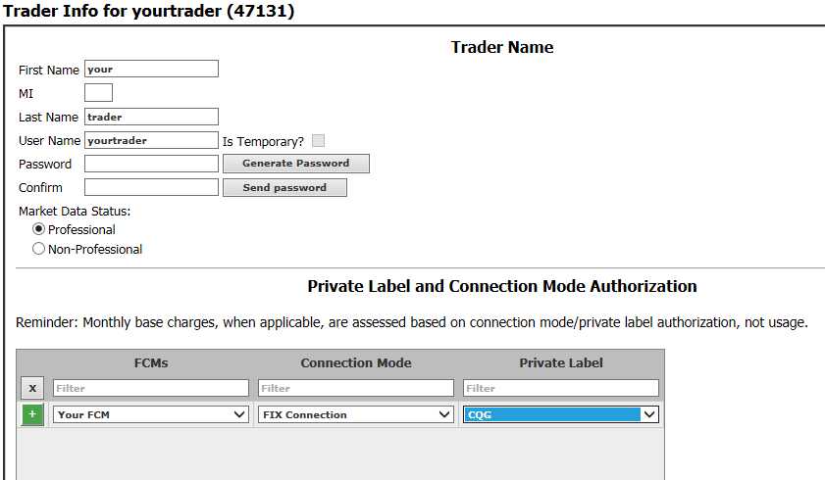
Click the + to set the change.

Slide 7
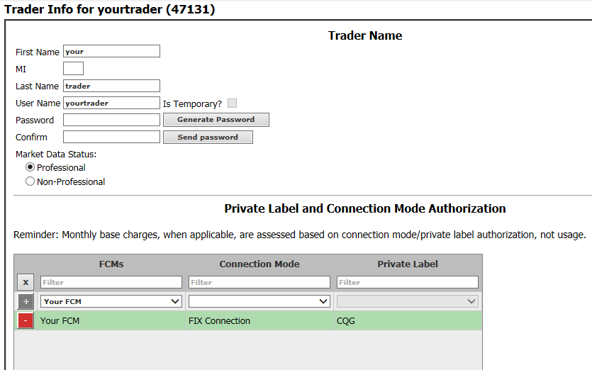
Save your changes. The Save button is found at the bottom of the page.

Slide 8
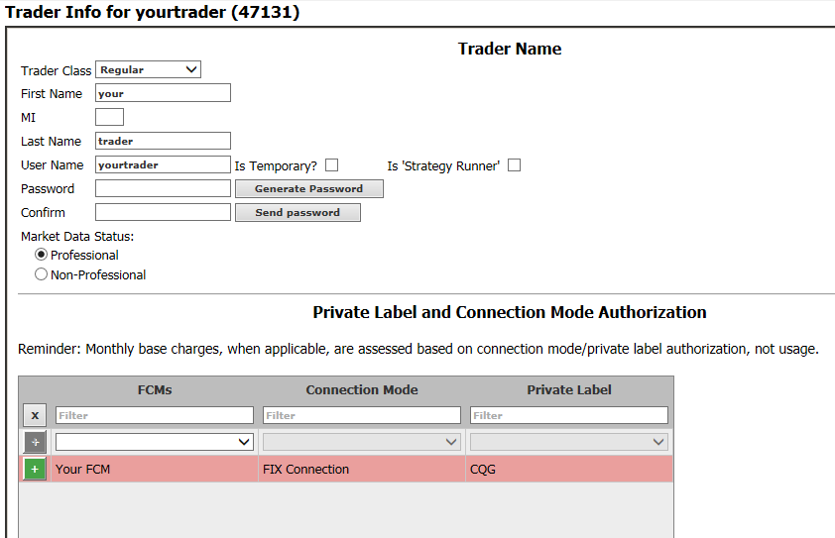
To remove a private label:
click the +
save the page
1.
2.

Slide 9
Configuring Market Data
Market data configuration and enablement now allow CQG to more accurately report exchange market data usage, and provide FCMs a more clear picture of the available market data options.

Slide 10
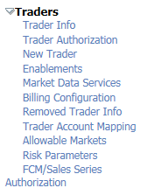
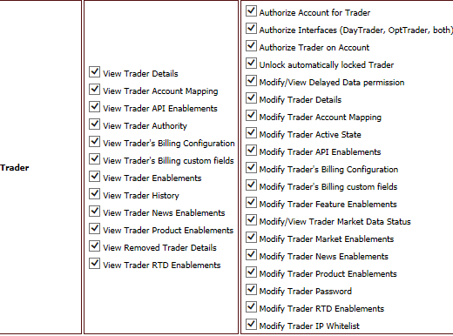
New menu item in CAST:
New CAST permission:

Slide 11
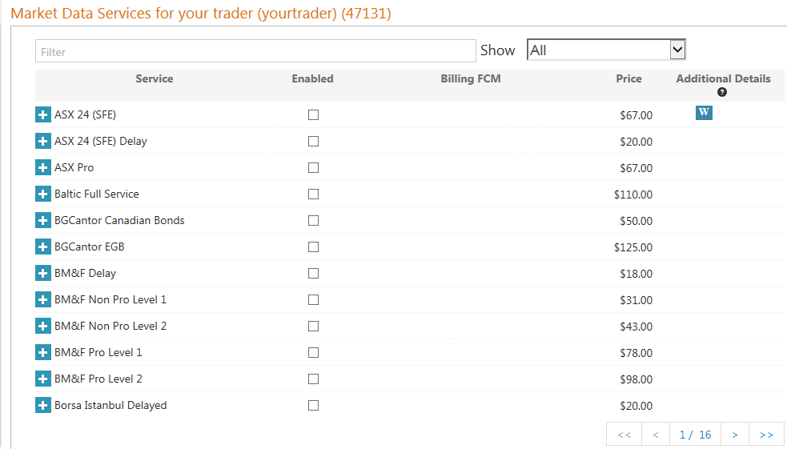
To enable exchanges for your trader, enter the exchange name in the Filter box or select the appropriate checkbox.
New CAST permission
* Please note that there are multiple pages

Slide 12
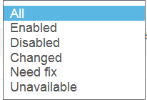
Use the drop-down box to quickly see what products are enabled, etc.
New CAST permission

Slide 13
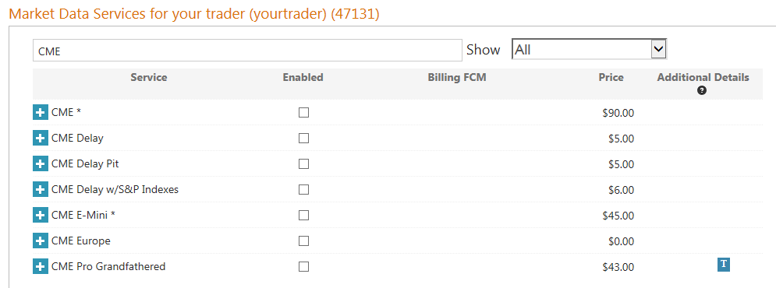
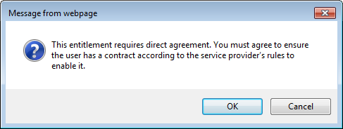
1. Choose the appropriate exchange enablement.
1.
2. A dialogue box will pop up after making a selection, confirm the selection.
3. Save the page when you are done making all selections.
2.
3.

Slide 14
Special Considerations
Historical data is listed within this page and is no longer on the Trader Enablements page of CAST
Delayed market data will prevent users from accessing charts in CQG M
The blue marker for indicates the fee is waived for traders
The blue marker for indicates the trader must be enabled for at least one instrument on the exchange to receive market data

